Slide 1
GYM MANAGEMENT SYSTEM
Team Members:
Praneeth Reddy Chinnasama- 700741138
Sushritha Reddy Sangam- 700742861

Slide 2
Description:
In our project we have introduced four modules named as Administrator, Branch manager, Gym trainer and customer. The administrator is going to manage the entire website, The branch manager will manage the gym branch activities. The gym trainer will train the customers. The customers are the service seekers. All the data of modules is handled by the database. The main purpose of using databases is to store information efficiently and securely, so that the information can be retrieved on demand.

Slide 3
We have Multiple branches for the Gym and the administrator will add the branch managers to respective branches. Then each branch of the gym is going to have a manager. The administrator can change the branch manager in a branch, furtherly according to the need. The administrator is going to add the packages into the system. Packages are nothing but the memberships which will include quarterly, half yearly and Annually plans. While adding the package the administrator is going to mention validity duration in months, price, package description, the trainer, who is going to help if customers need support … etc. The administrator can view the packages which are added. These added packages are commonly available for the customers in all branches

Slide 4
Modules:
Administrator:
Add manager
View manager
Add packages
View packages

Slide 5
Branch manager:
Add trainer
View Trainer
activate / deactivate trainer
Add customer
View customers
Assign customer to trainer

Slide 6
Gym Trainer:
View customers
Add food diet
View food diet
Add exercise diet for customer
View exercise diet for customer
Update customer progress

Slide 7
Customer:
Register
View packages
Enrol packages
View enrolled packages
View profile
View food diet schedule
View exercise schedules

Slide 8
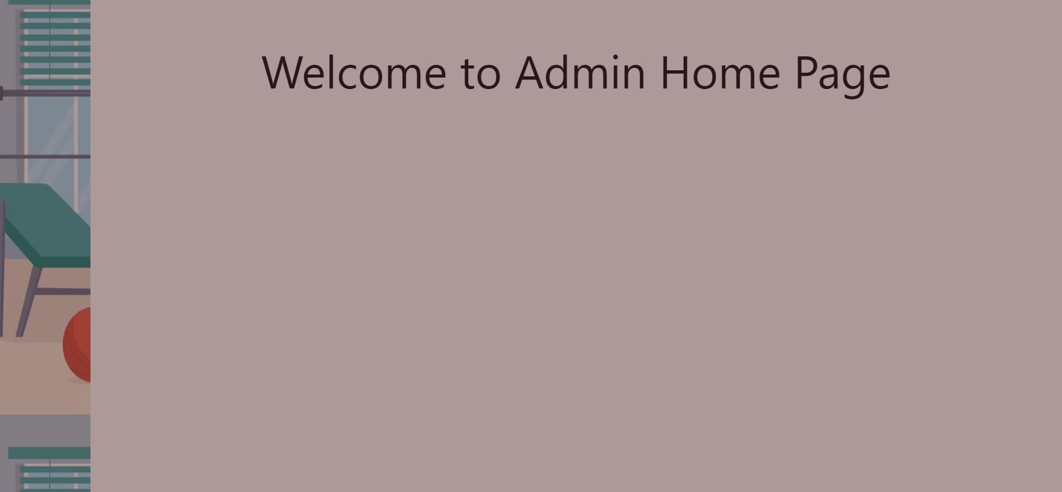
Admin Home page:

Slide 9
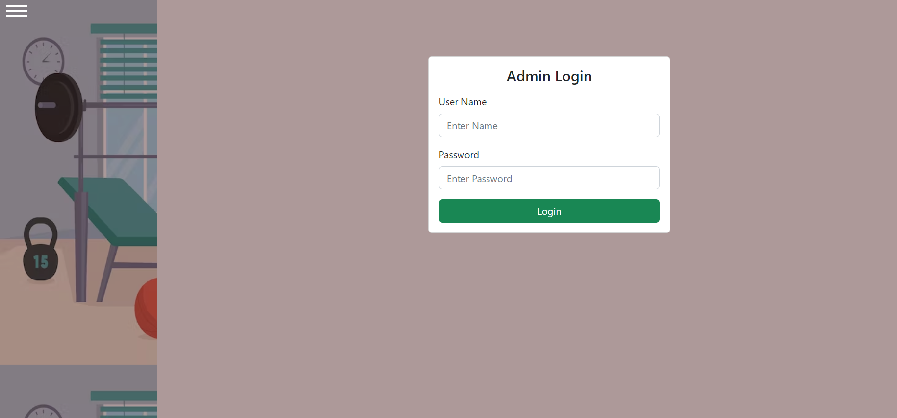
Admin Login Page:

Slide 10
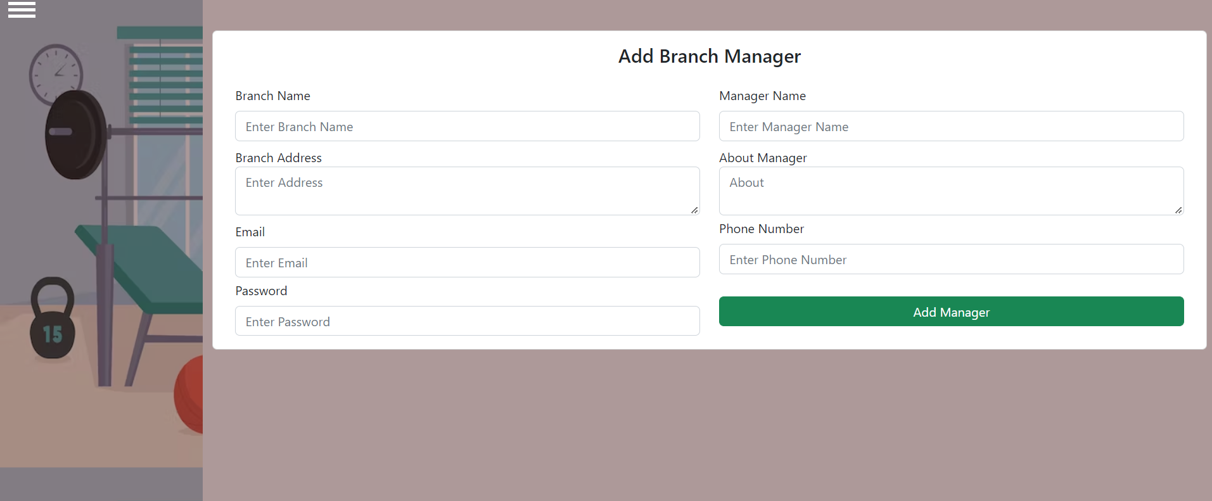
Add Branch Manager:

Slide 11
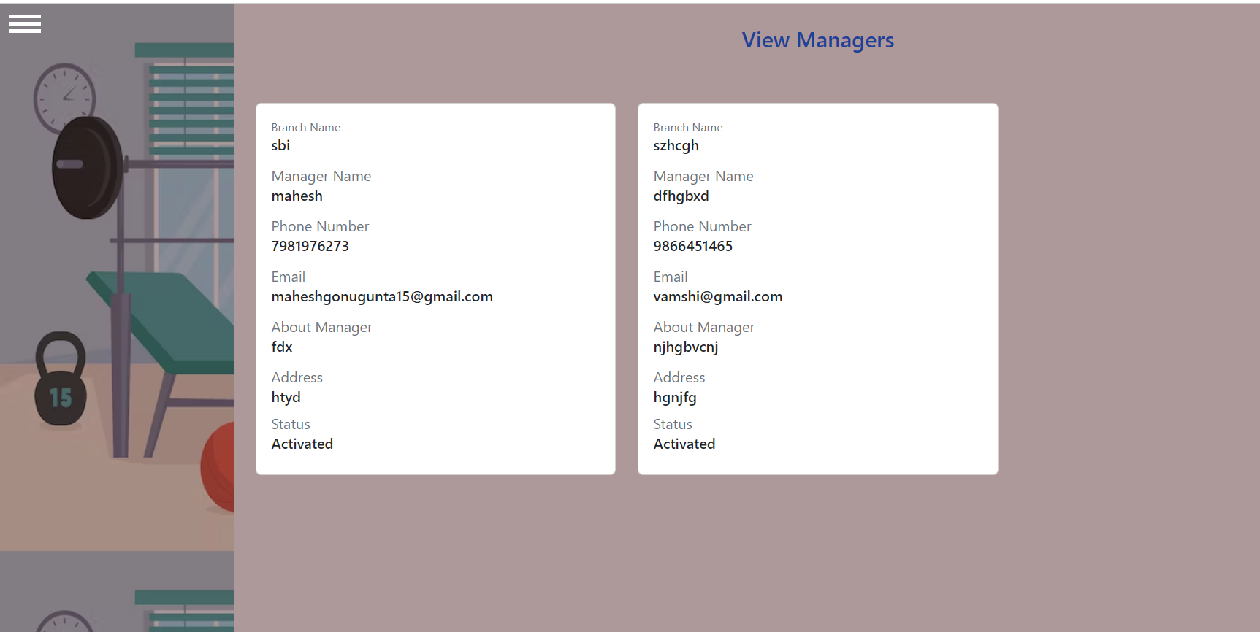
View Branch Manager:

Slide 12
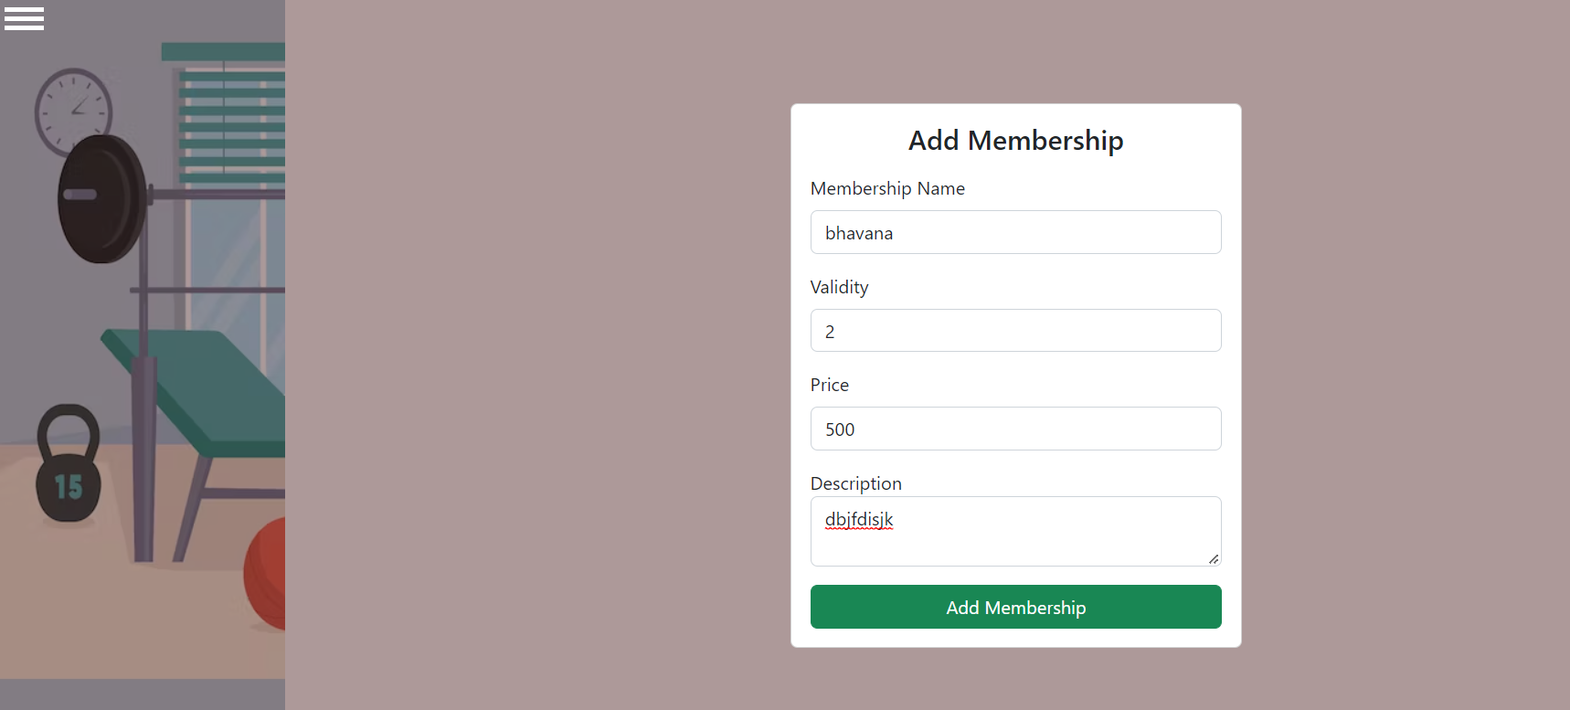
Add Member ship:

Slide 13
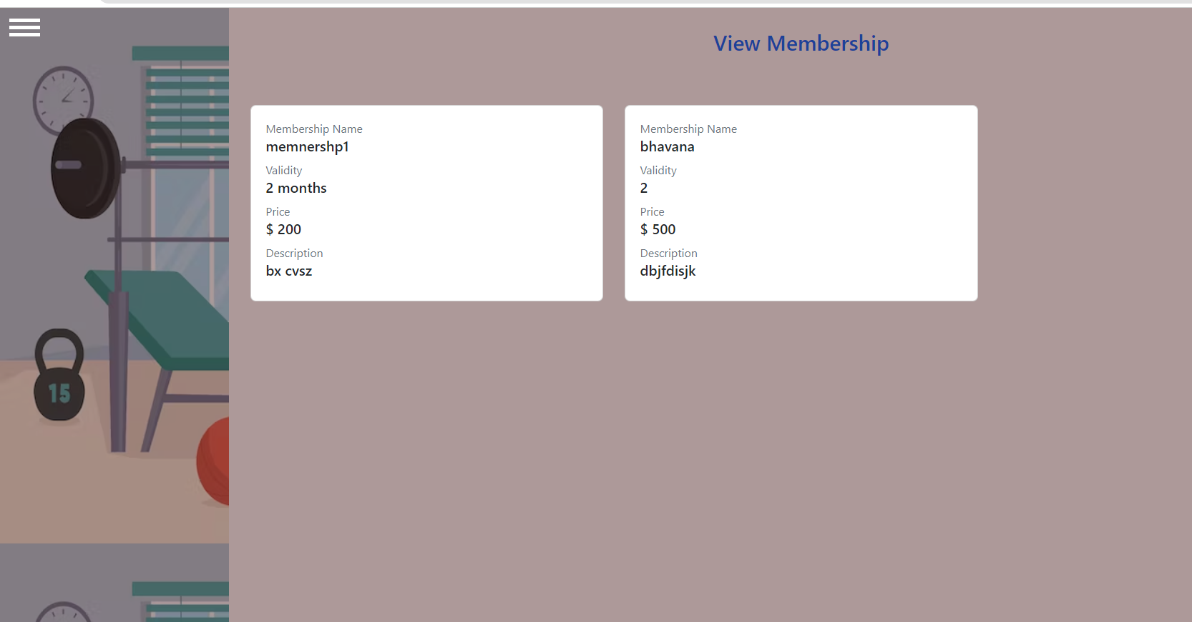
View Membership:

Slide 14
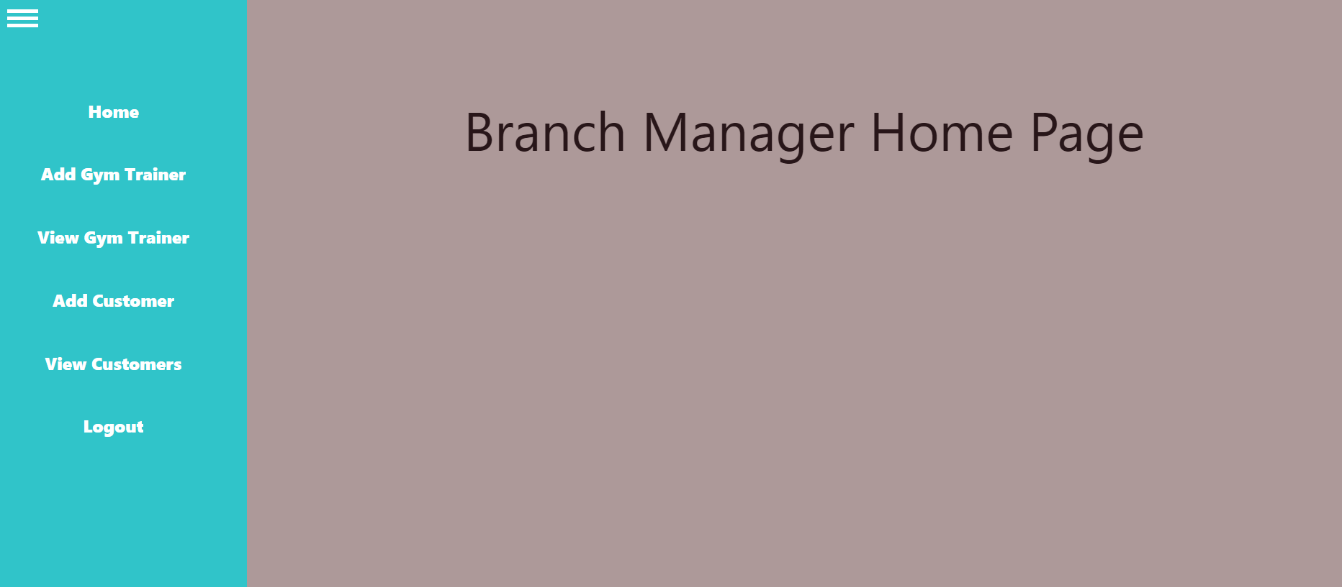
Branch Manager Home page

Slide 15
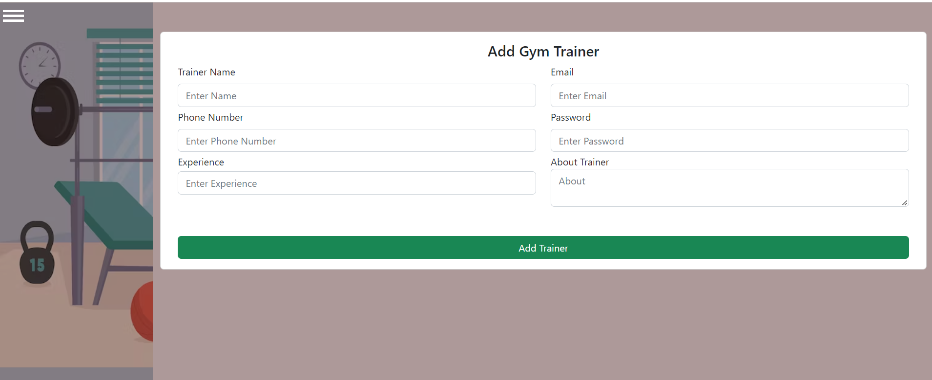
Add Gym Trainer

Slide 16
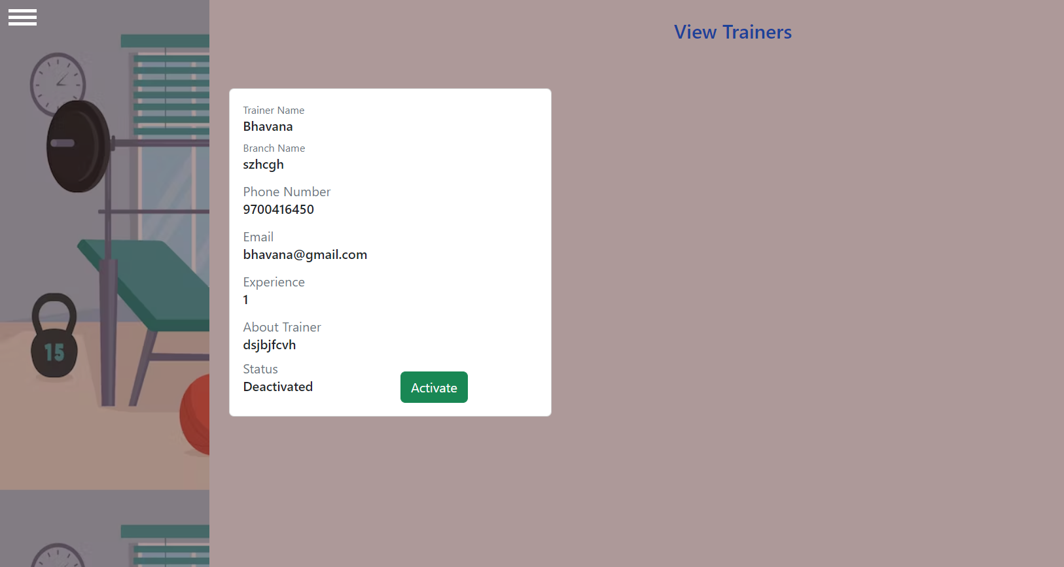
View Gym Trainer

Slide 17
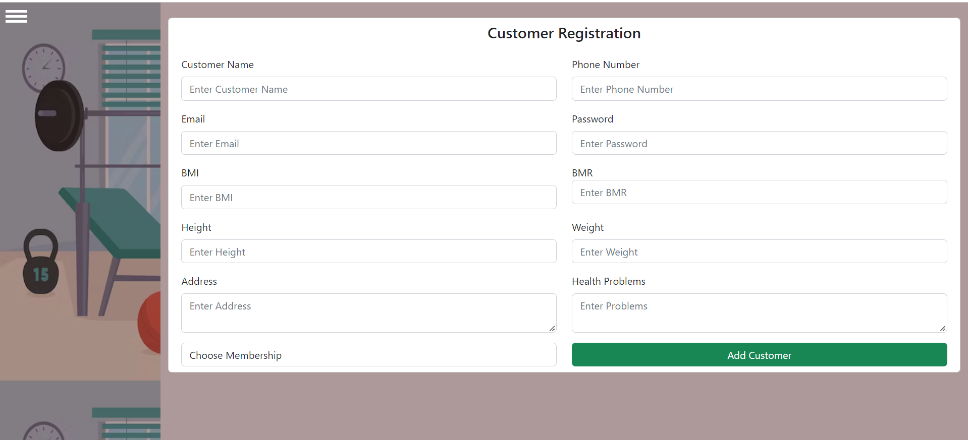
Customer Registration

Slide 18
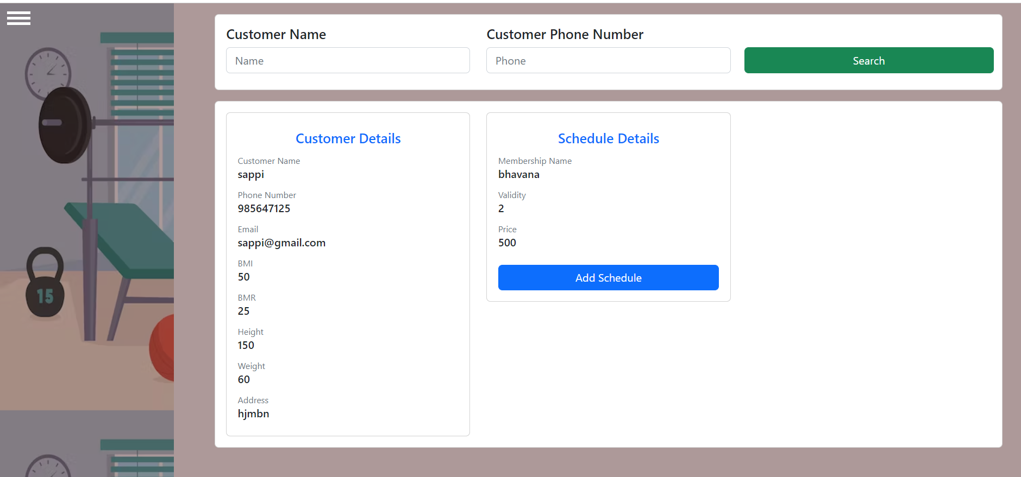
View Customer page

Slide 19
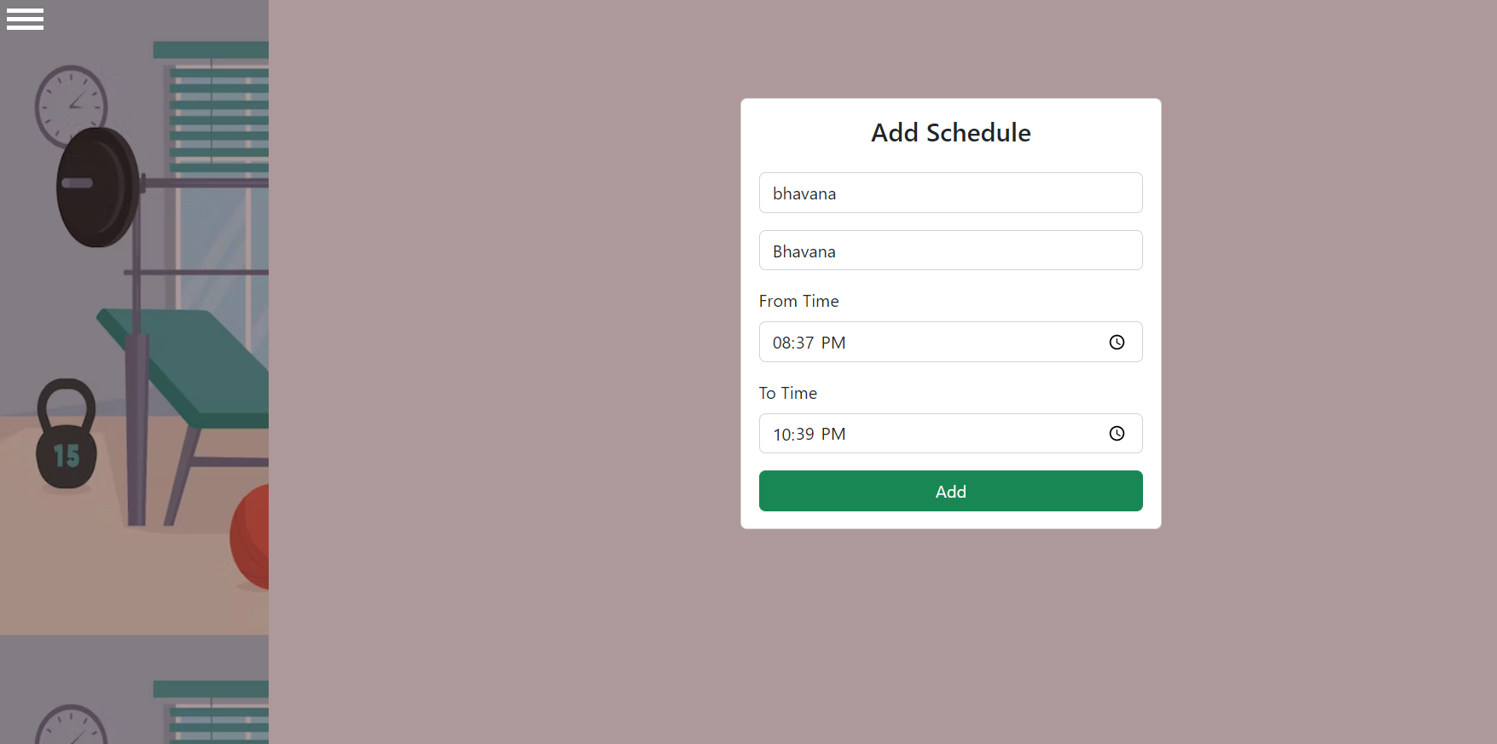
Add Schedule

Slide 20
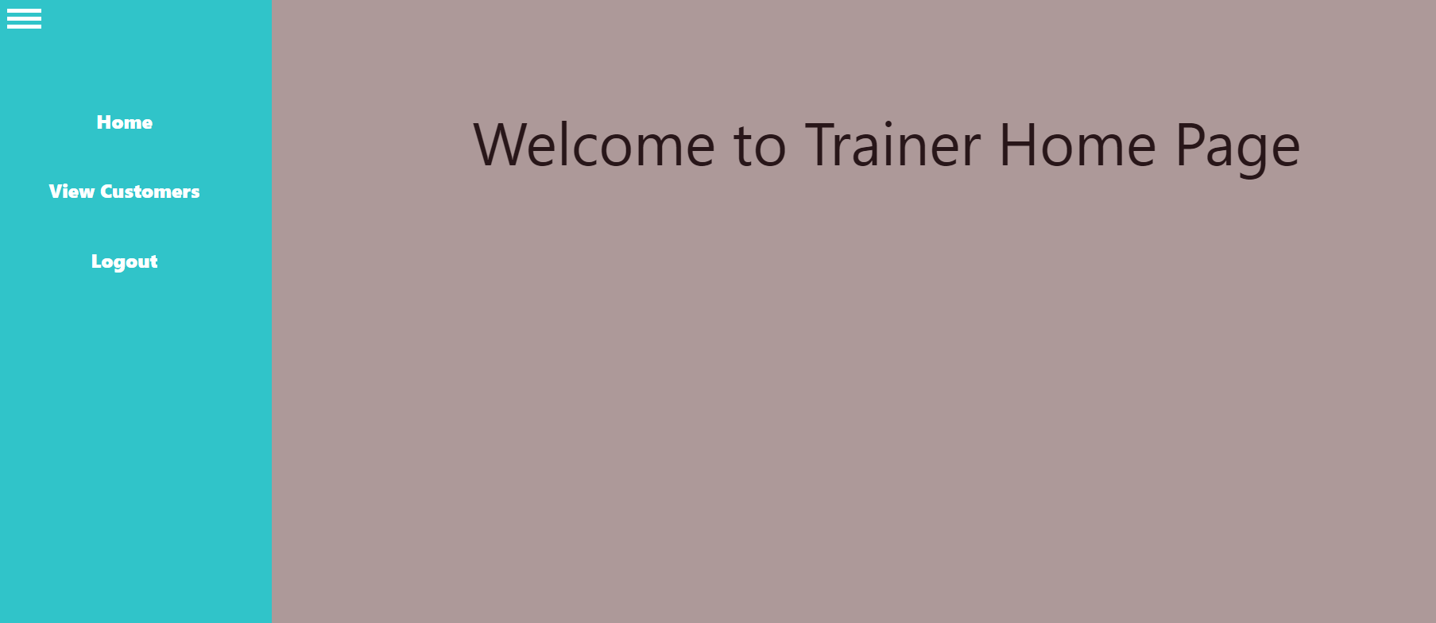
Gym Trainer Home Page

Slide 21
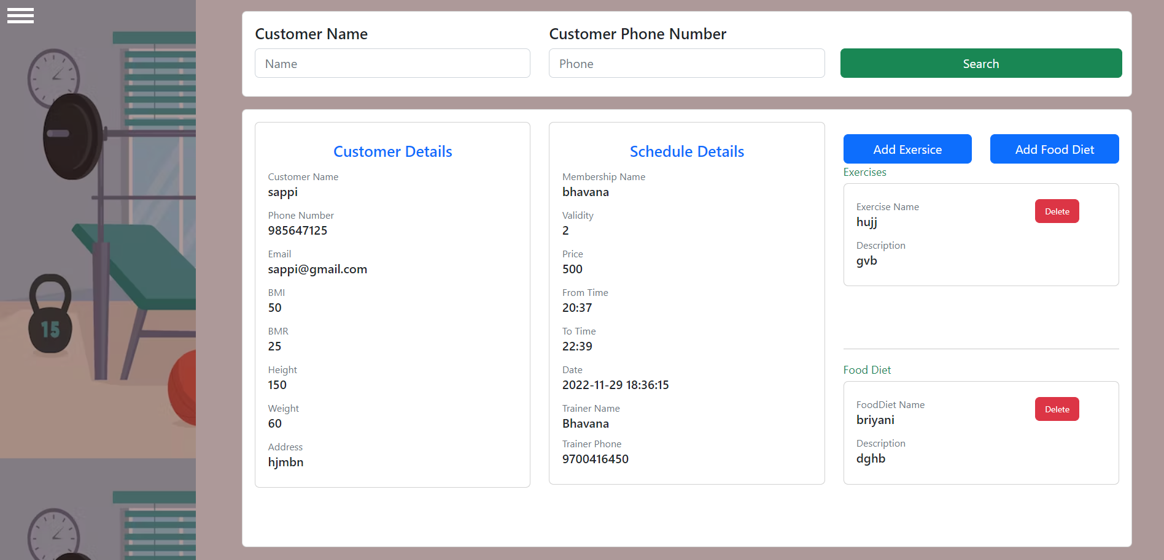
View Customers

Slide 22
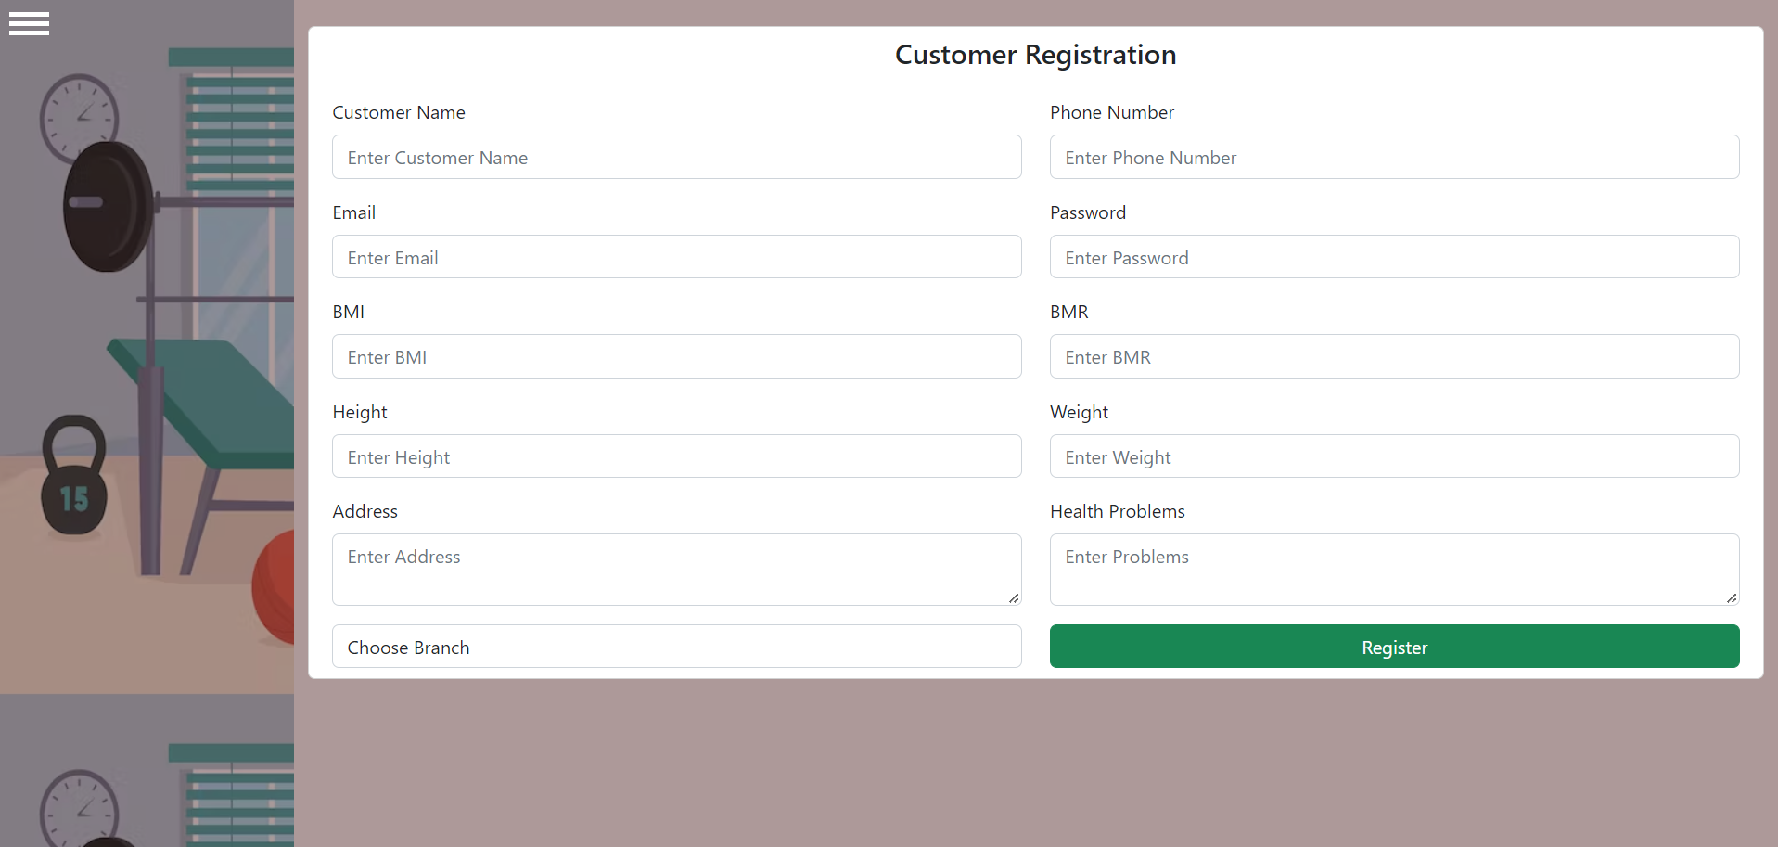
Customer Registration Page

Slide 23
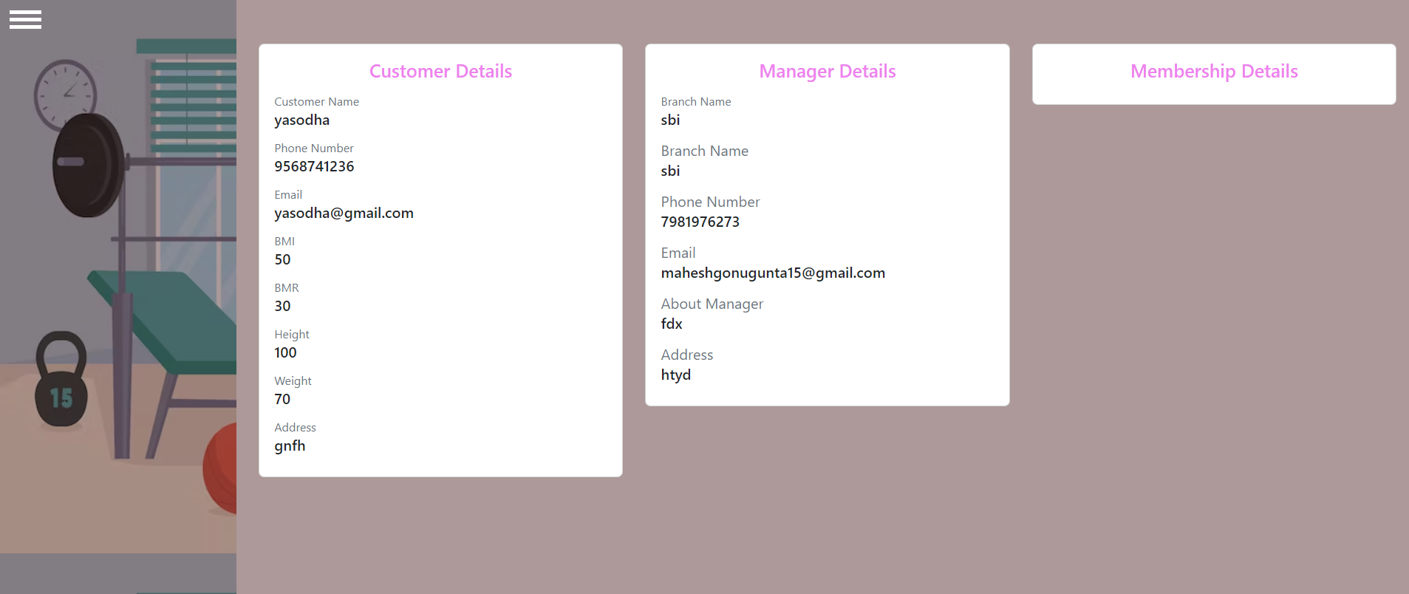
Customer Login page

Slide 24
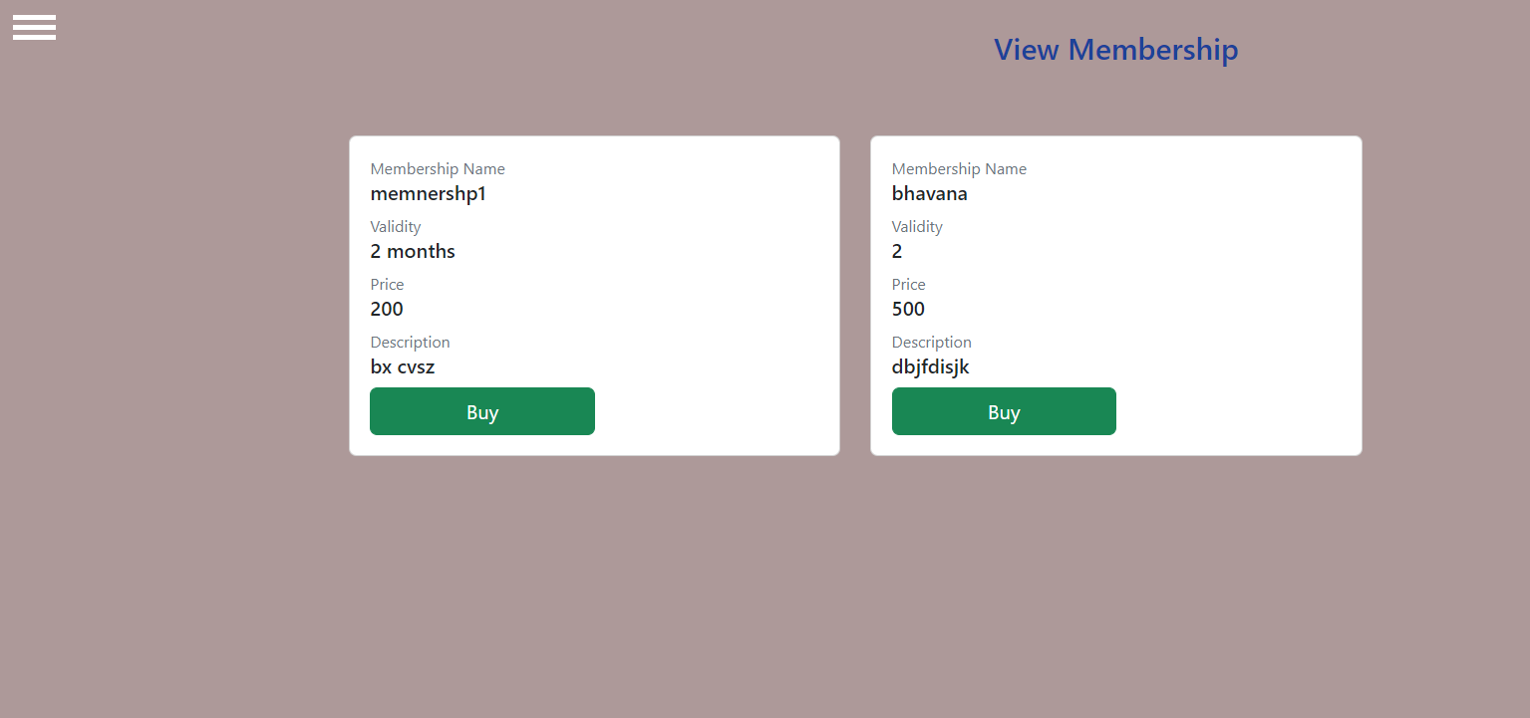
View Membership

Slide 25
conclusion
We have done a project on Gym Management system . The admin should register and login to the website.The gym trainer login with their credentials customer has to register first and then login into the page

